Slide 1
My AWS Environment and how I got there
A summary of my past few months of intensively trying to grasp a hold of cloud… and succeeding in it

Slide 2
It all started in April…
AWS Cloud Fundamentals course in Laurea UAS (April–May, 3 ECTS)
  Cloud Concepts Overview
  Cloud Economics and Billing
  AWS Global Infrastructure
  AWS Cloud Security
  Networking and Content Delivery
  Compute
  Storage
  Databases
  Cloud Architecture
  Automatic Scaling and Monitoring

Slide 3
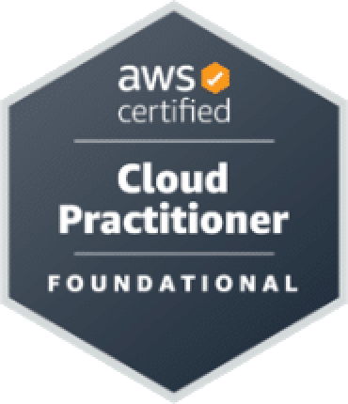
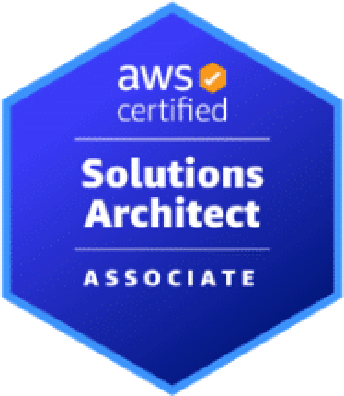
…and continued into the summer
AWS Certified Cloud Practitioner CLF-C02 June 12, 2025
  Cloud Concepts
  Security and Compliance
  Cloud Technology and Services
  Billing, Pricing, and Support
AWS Certified Solutions Architect SAA-C03 July 28, 2025
  Designing Secure Architectures
  Designing Resilient Architectures
  Designing High-Performing Architectures
  Designing Cost-Optimized Architectures

Slide 4
There’s been a lot of effort to get better and to achieve the certs
Hundreds of hours spent in AWS Skill Builder
  Certification learning paths consisted of
    Learning videos
    SimuLearn labs
    Escape Room games
    Cloud Quest games
    Practice exams
See more of more detailed information on the skills I’ve acquired through this journey at the end of the presentation

Slide 5
The Environment

Slide 6
My AWS environment
I built my own AWS environment utilizing many different AWS services
  I migrated applicable parts of my already existing digital resources (e.g. web apps on Netlify, projects on GitHub) into AWS Cloud
  There’s three main components I focused on migrating
    My website jonimakinen.com
    A simple full stack app Translation Game
    An SPA study tracker on the web Curriculus
  I built microservice applications around these main components
    Different AWS services play together to form fully functioning applications in the cloud

Slide 7
Let’s first take a quick look at the migrated main components

Slide 8
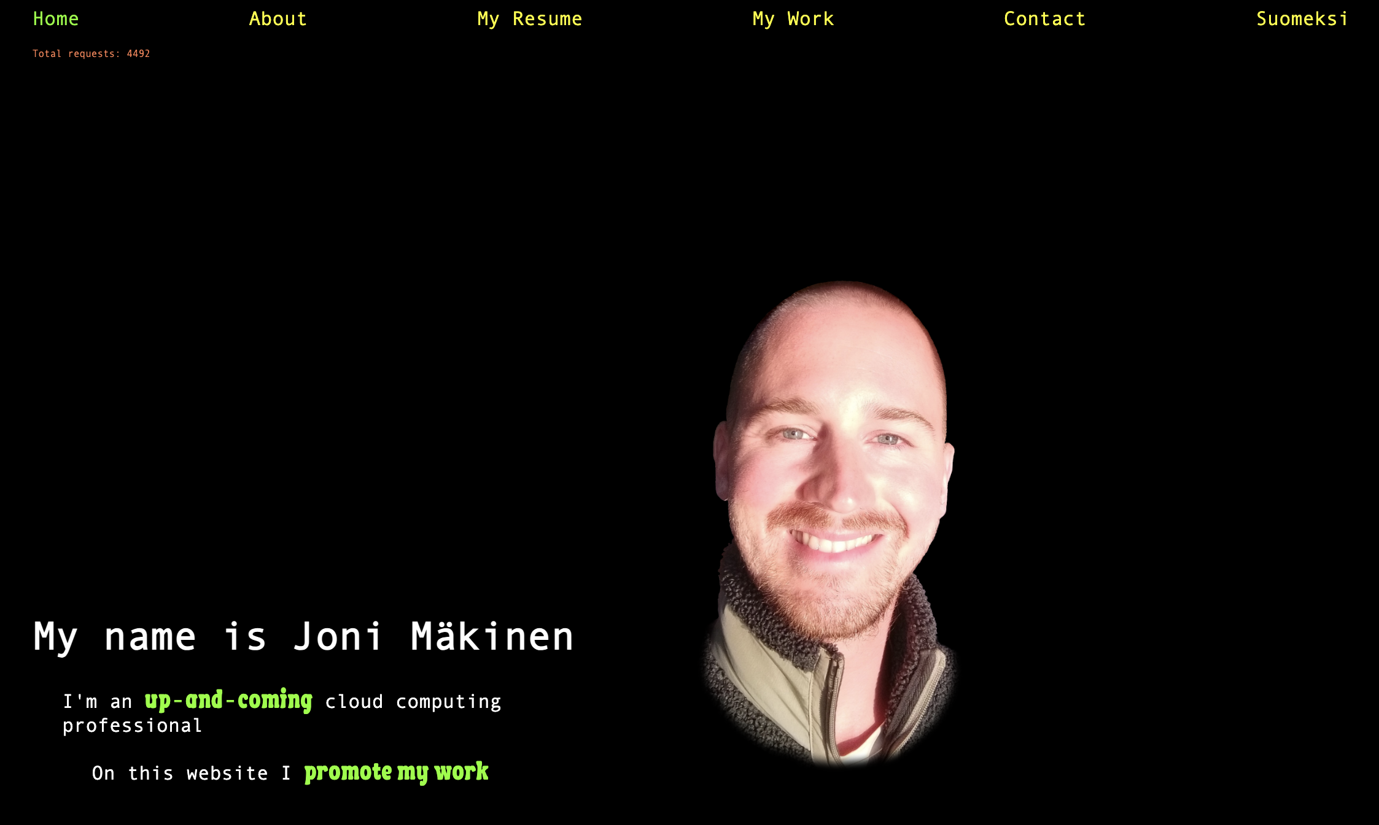

Slide 9
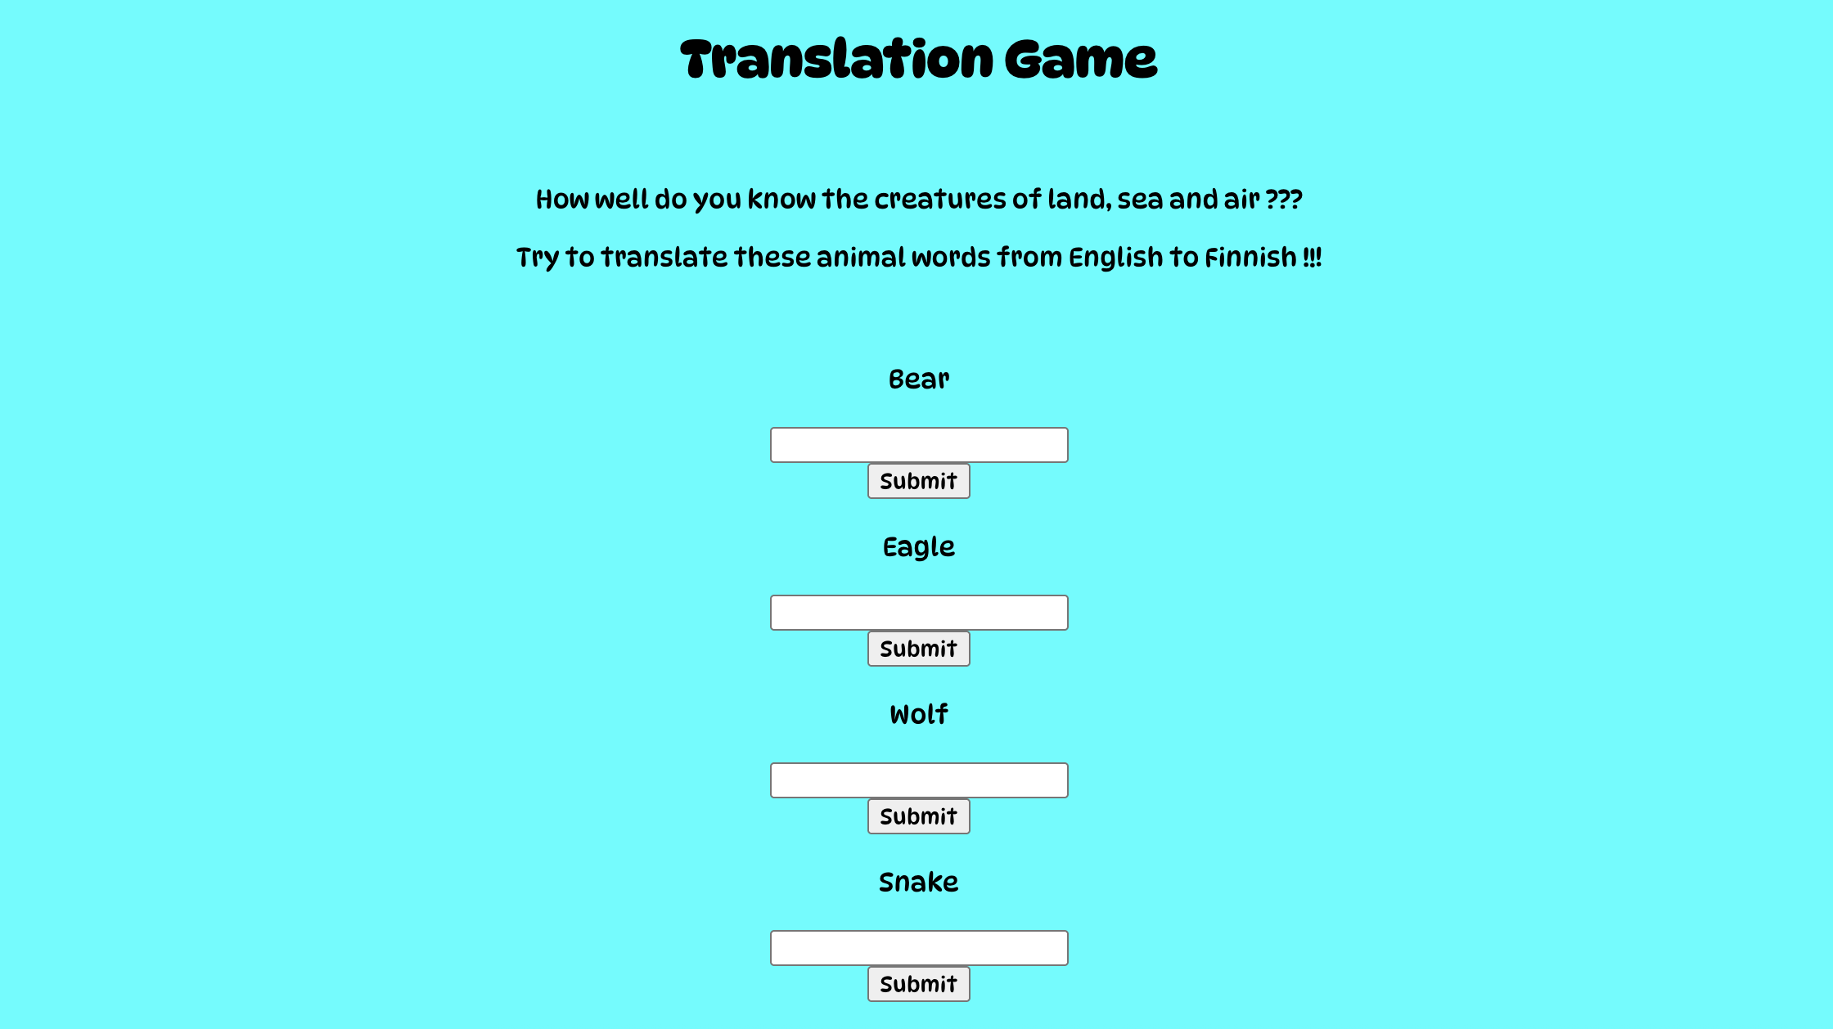

Slide 10
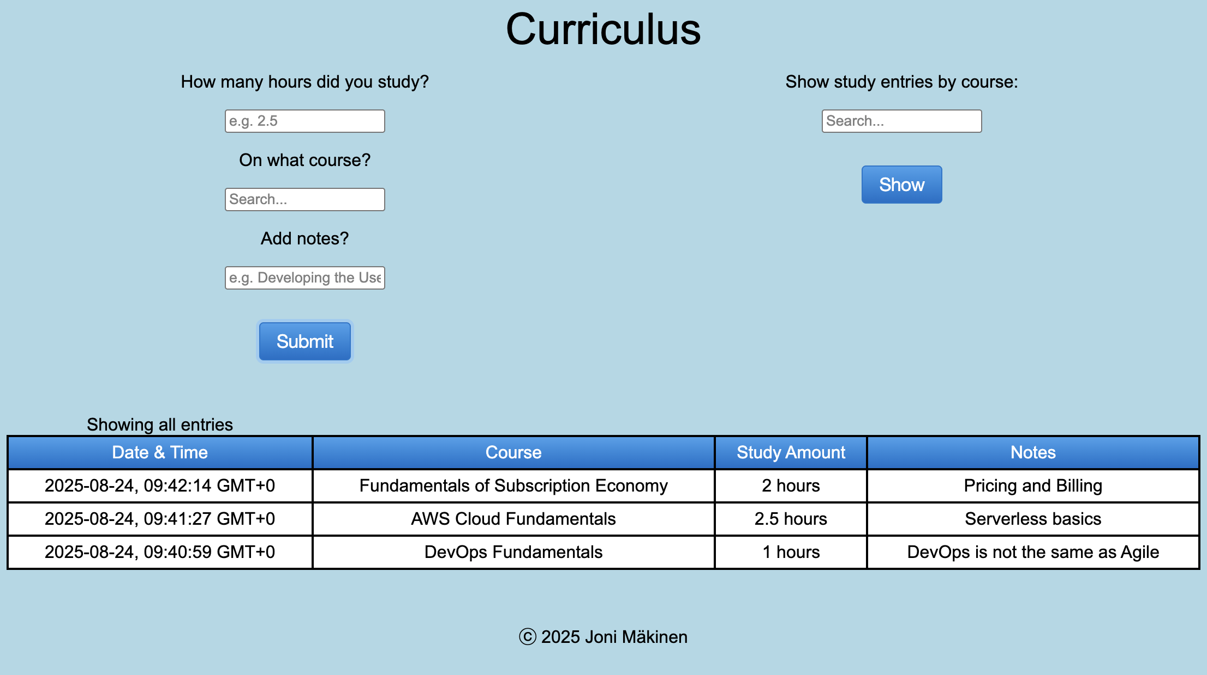

Slide 11
Let’s then delve into the microservice applications

Slide 12

Microservice applications
There are 5 different applications I’m about to present to you
    1. Static Website Hosting
    2. Website Request Counting built around jonimakinen.com
    3. Email Notification
    4. Application Hosting (VPC) built around Translation Game
    5. API Gateway
    with Lambda Integration built around Curriculus
    and DynamoDB Connection
The applications consist of a diverse group of AWS services
from different service categories

Slide 13
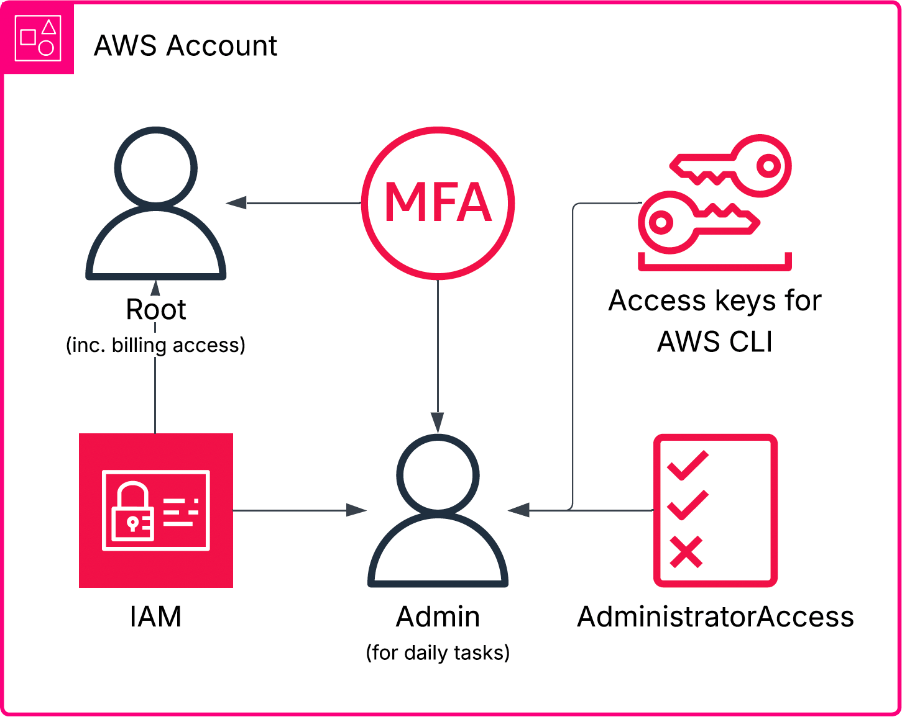
Before we go see the first application…

Slide 14

1. Static Website Hosting
Microservice application

Slide 15
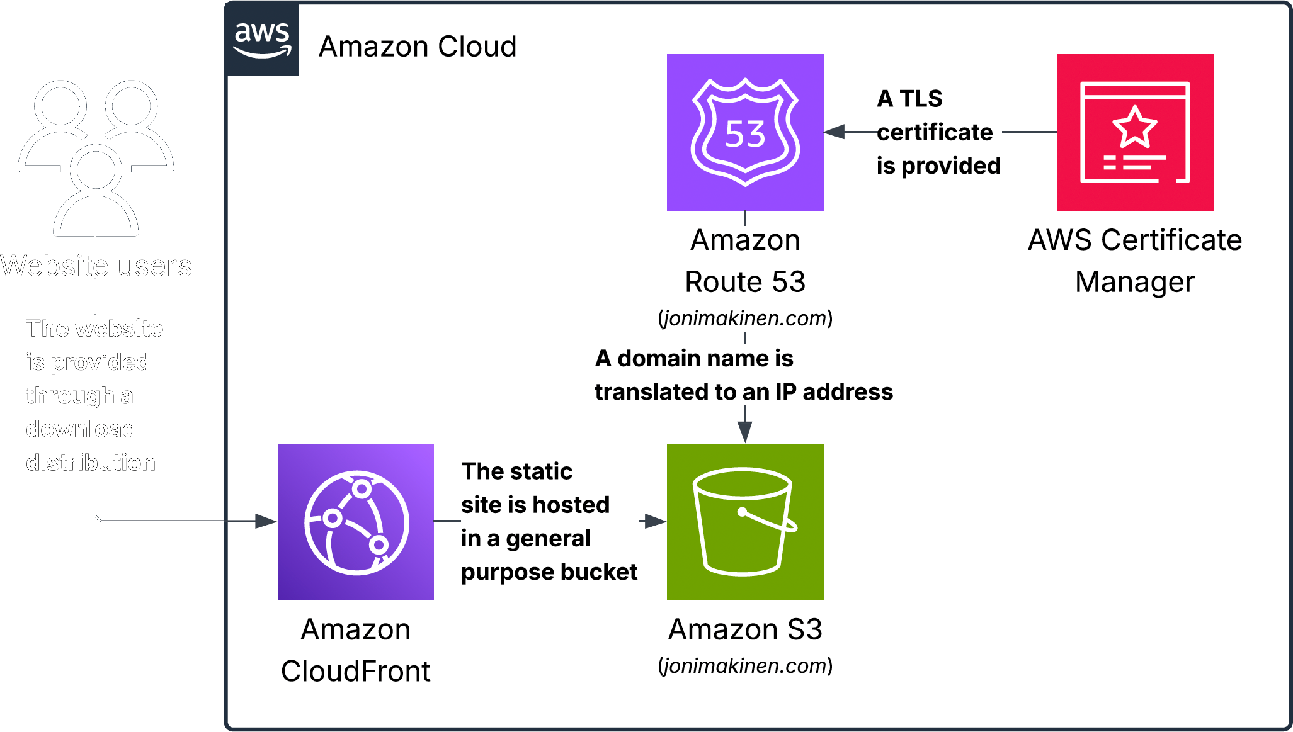
Static Website
Hosting jonimakinen.com

Slide 16
2. Website Request Counting
Microservice application

Slide 17
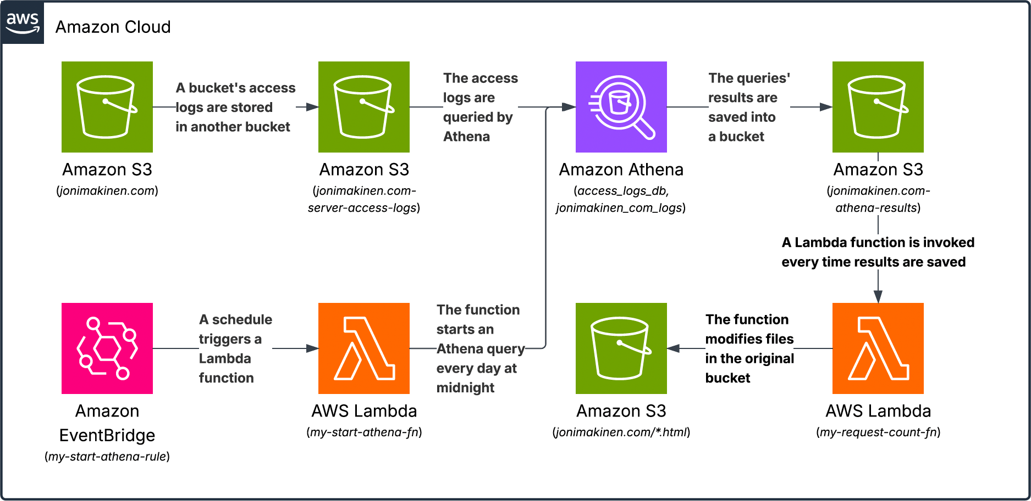
Website Request
Counting jonimakinen.com

Slide 18
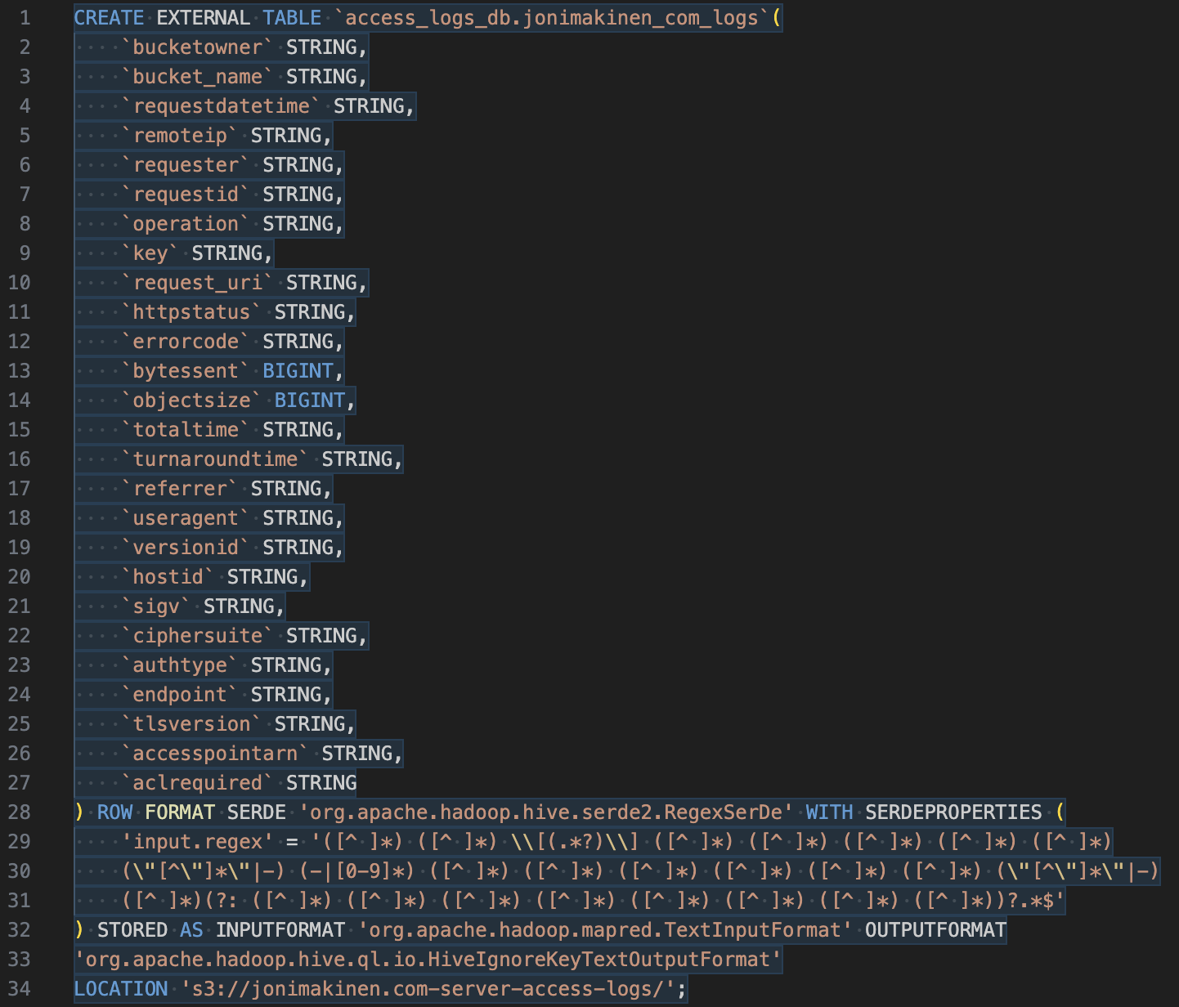

Athena SQL commands
Website Request Counting

Slide 19
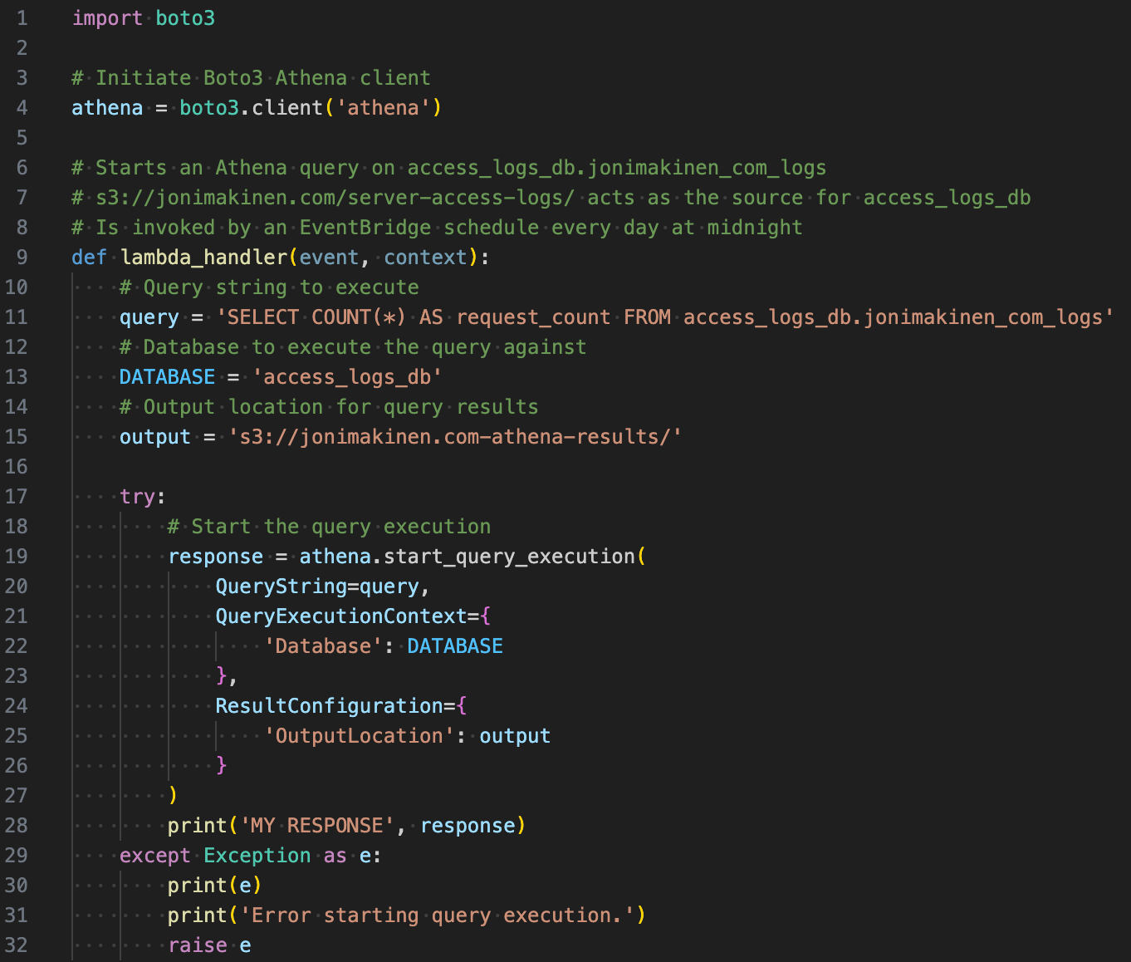
My-start-athena-fn
Lambda
Website Request counting

Slide 20
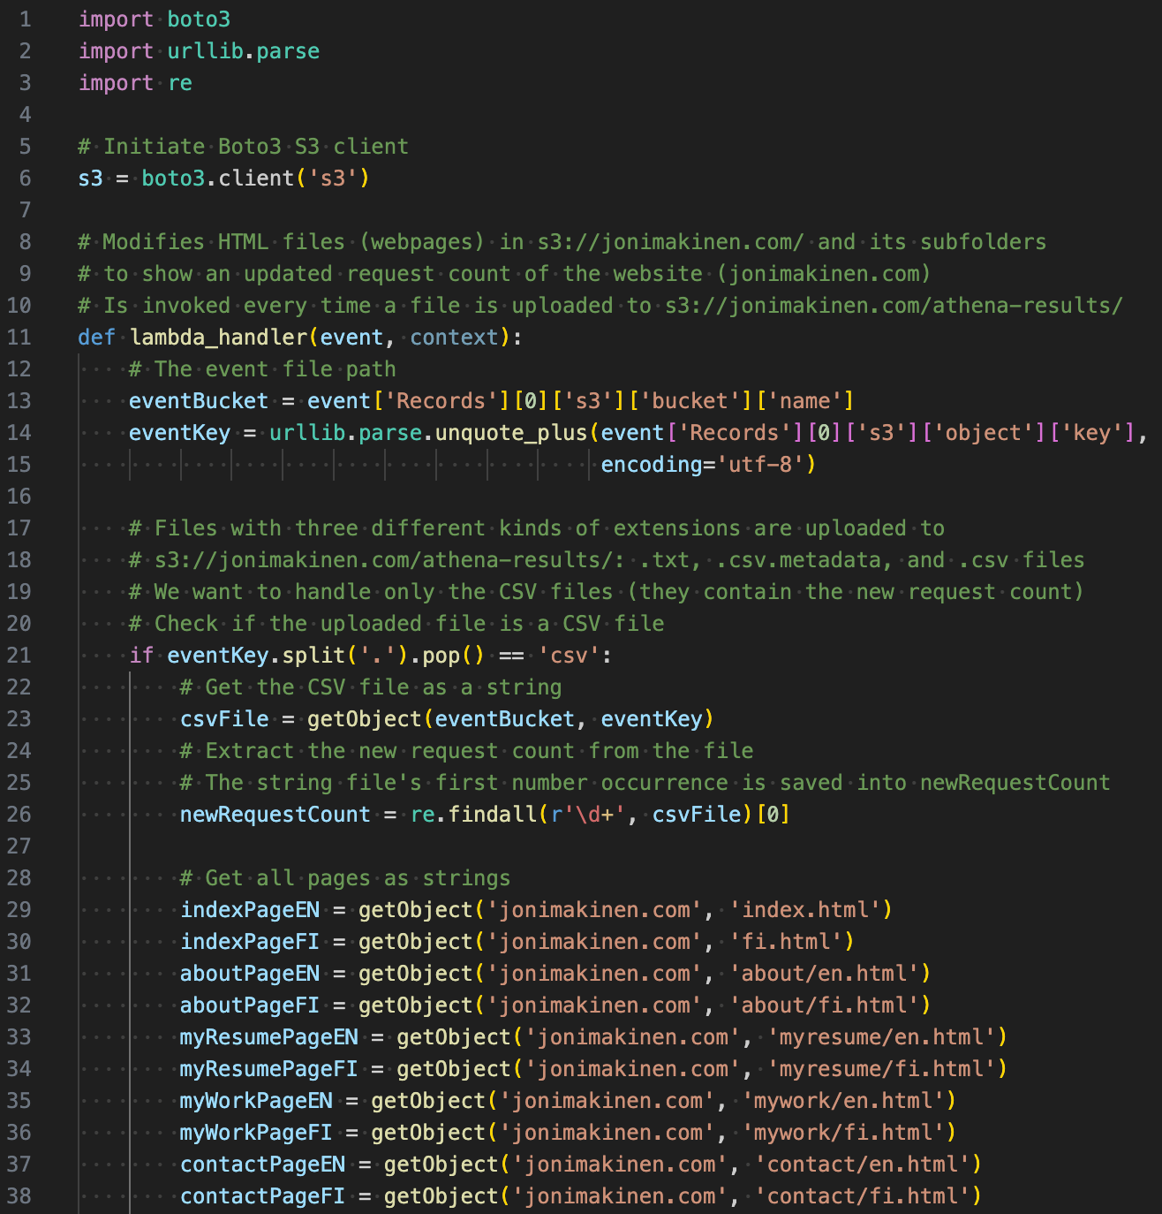
My-request-count-fn
Lambda 1/3
Website Request Counting

Slide 21
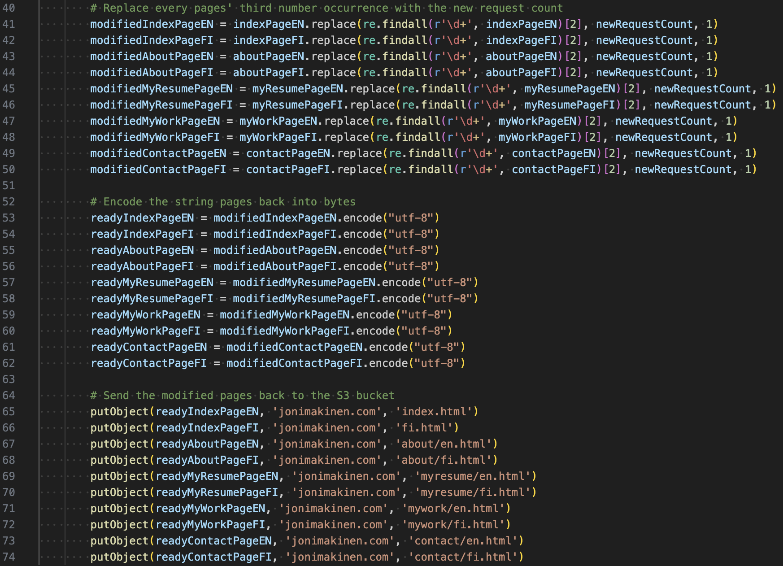
my-request-count-fn
Lambda 2/3
Website Request Counting

Slide 22
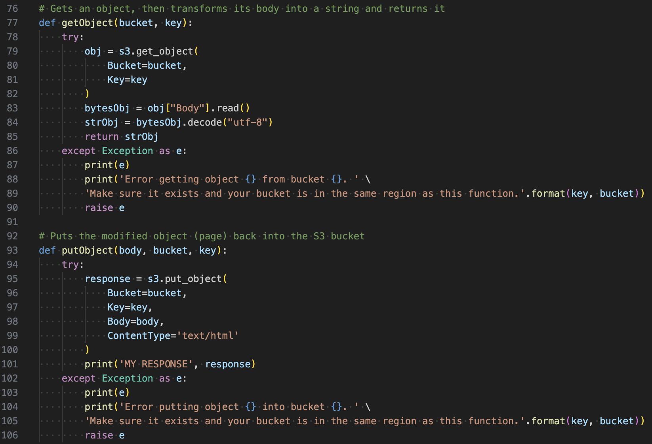
my-request-count-fn
Lambda 3/3
Website Request Counting

Slide 23
3. Email Notification
Microservice application

Slide 24
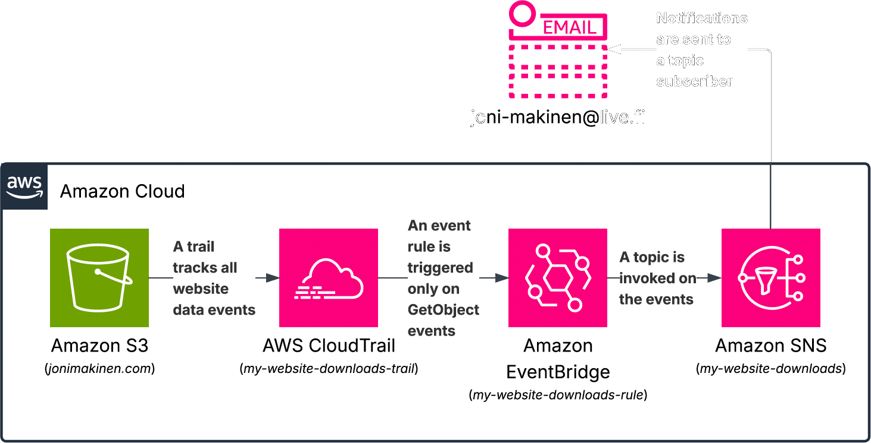
Email notification jonimakinen.com

Slide 25

4. Application Hosting (VPC)
Microservice application

Slide 26
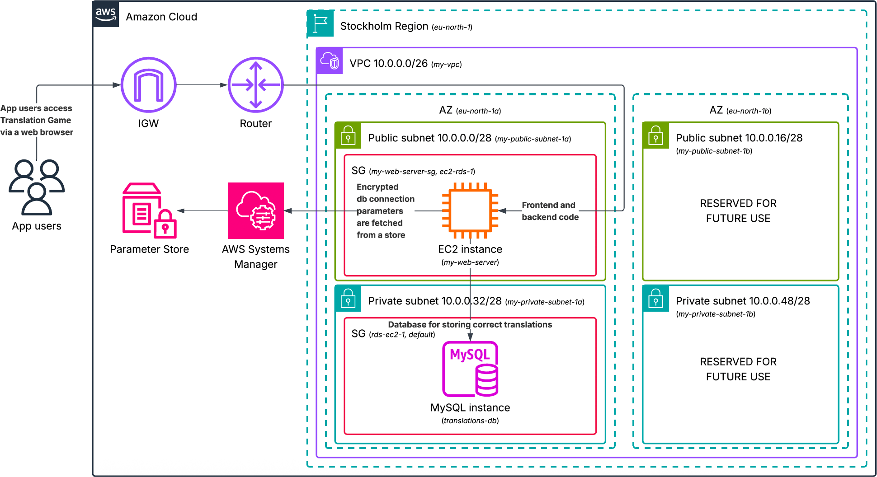
Application Hosting (VPC) a VPC accommodating a 3-tier full stack app

Slide 27
my-web-server
EC2 instance
Application Hosting (VPC)
Associated with an Elastic IP
Assigned an IAM instance profile to give permission to fetch parameters from AWS SSM Parameter Store
Key pair in use for SSH connections
Launches with user data
  Fetches parameters needed for database connection from Parameter Store
  Installs needed packages with Yum
  Downloads Translation Game from S3
  Installs Node.js dependencies
  Starts servers on ports 8080 and 3000

Slide 28
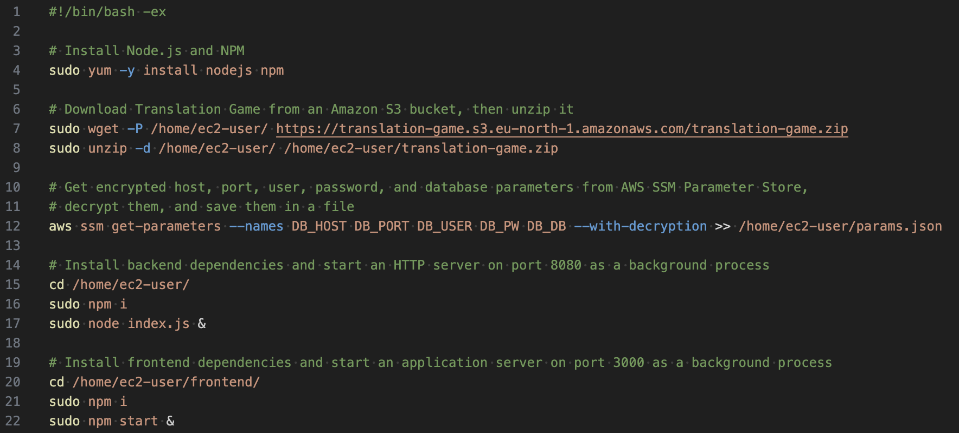
My-web-server user data script
Application Hosting (VPC)

Slide 29
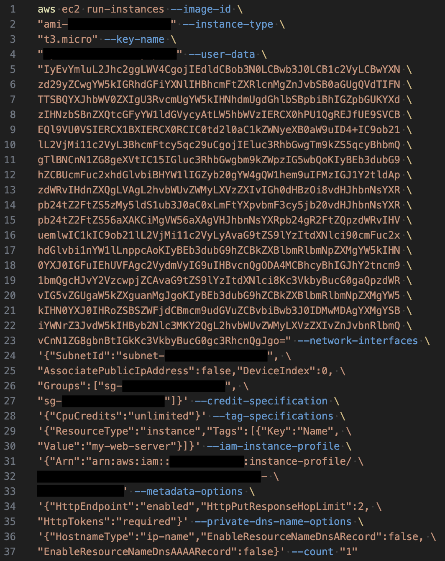
Launching
My-web-server via AWS CLI
Application Hosting (VPC)

Slide 30
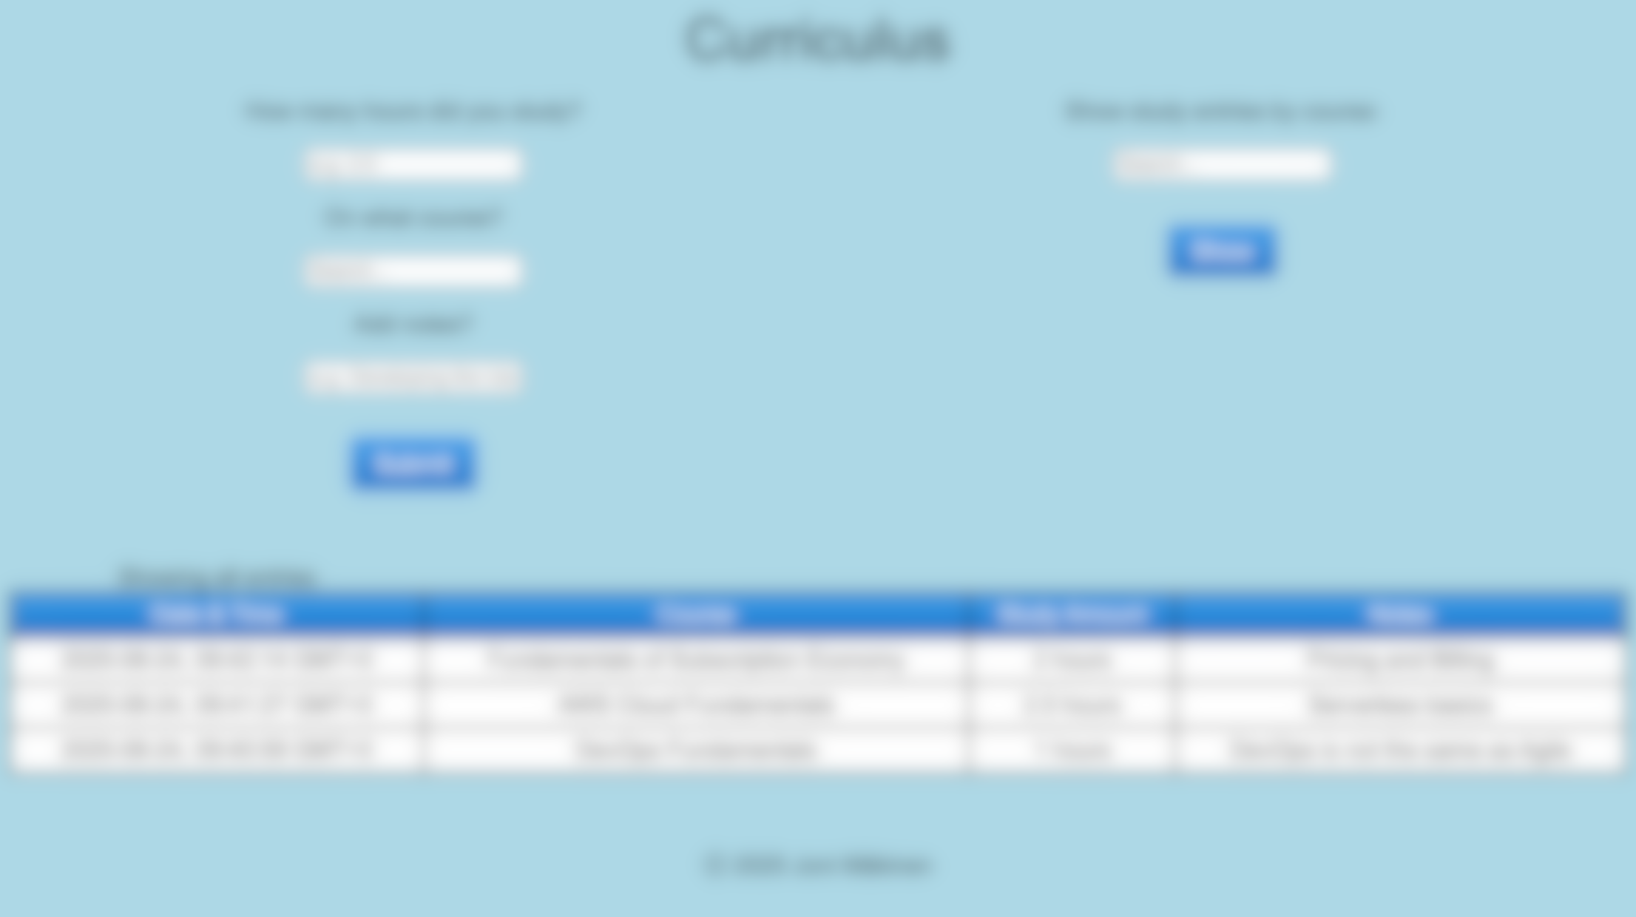
5. API Gateway with Lambda Integration and DynamoDB Connection
Microservice application

Slide 31
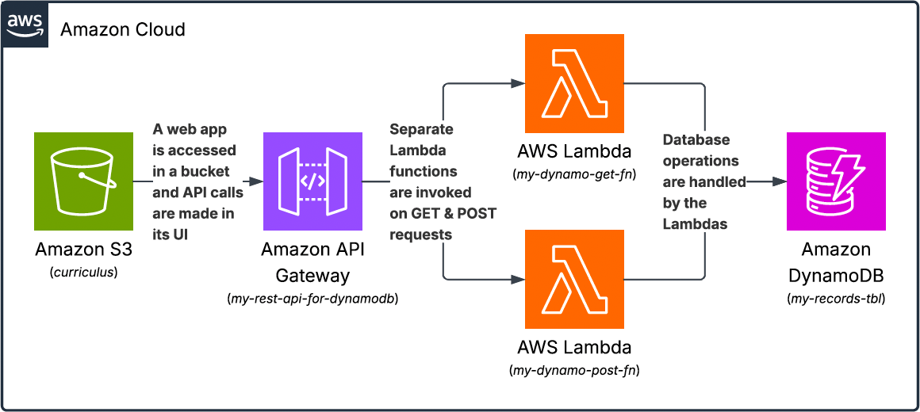
API Gateway with Lambda Integration and DynamoDB Connection
Curriculus

Slide 32
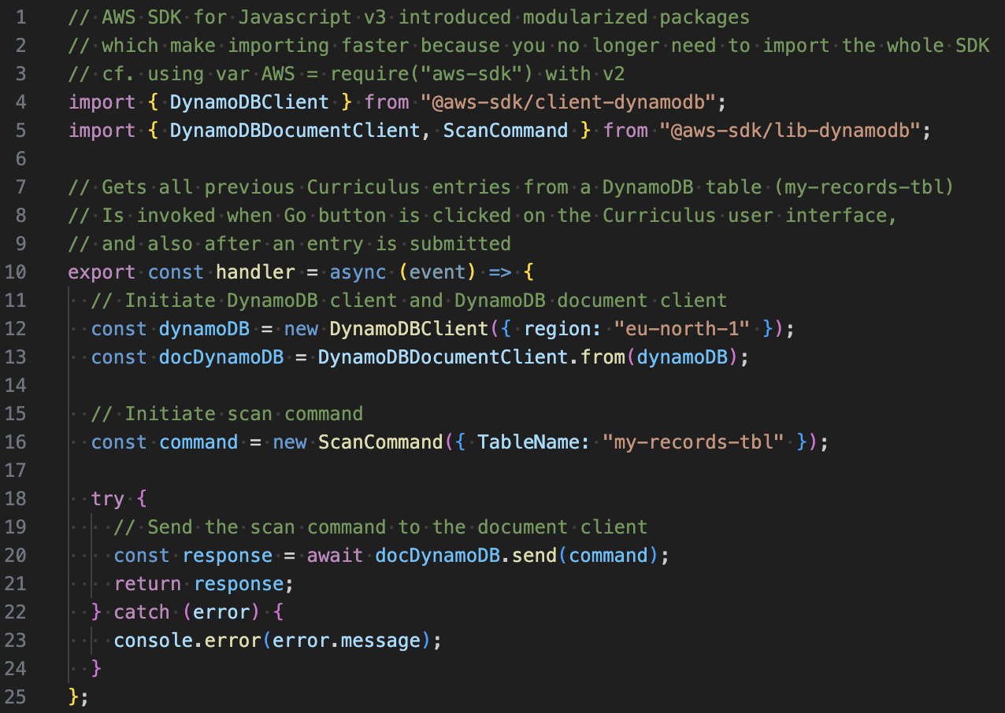
My-dynamo-get-fn
Lambda
API Gateway with Lambda Integration and DynamoDB Connection

Slide 33
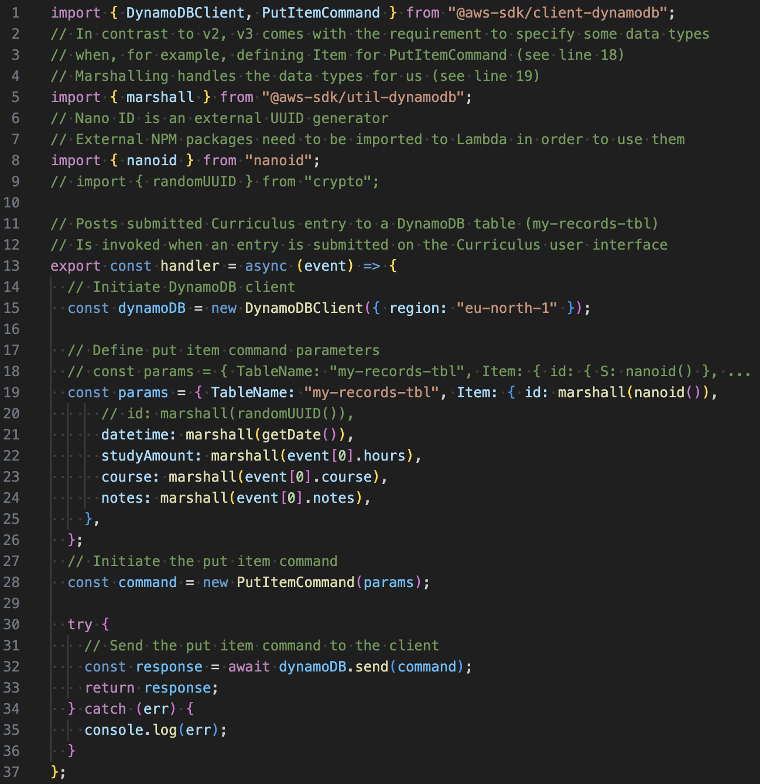
My-dynamo-post-fn
Lambda 1/2
API Gateway with Lambda Integration and DynamoDB Connection

Slide 34
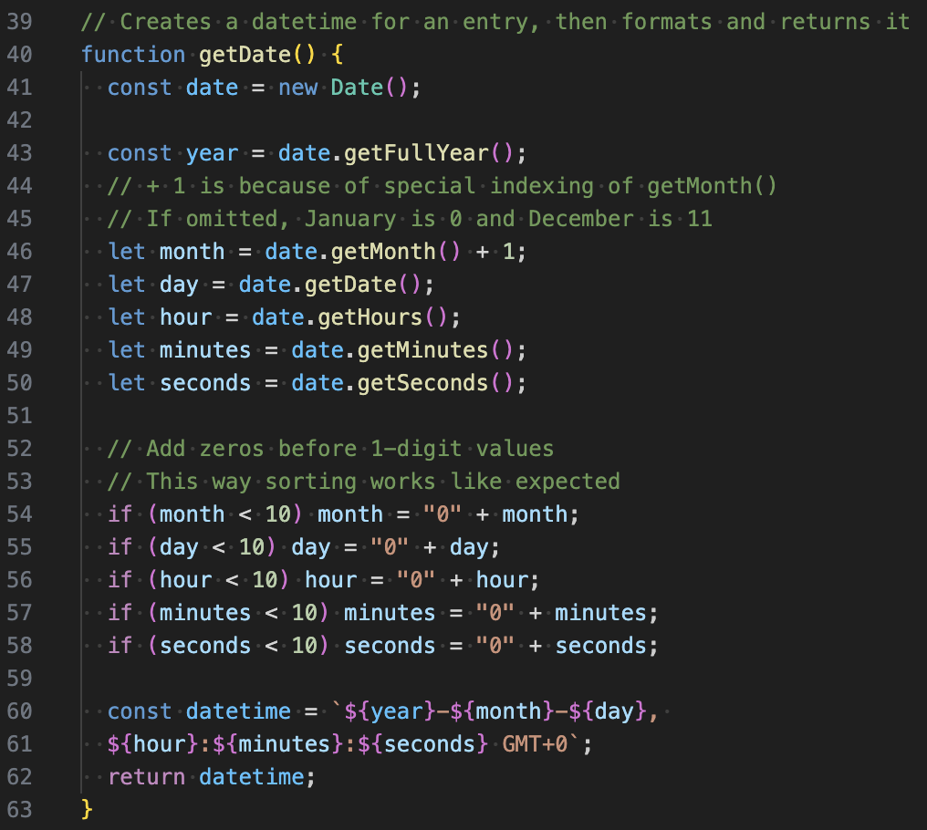
My-dynamo-post-fn
Lambda 2/2
API Gateway with Lambda Integration and DynamoDB Connection

Slide 35
What could I have done differently? what could I improve?

Slide 36
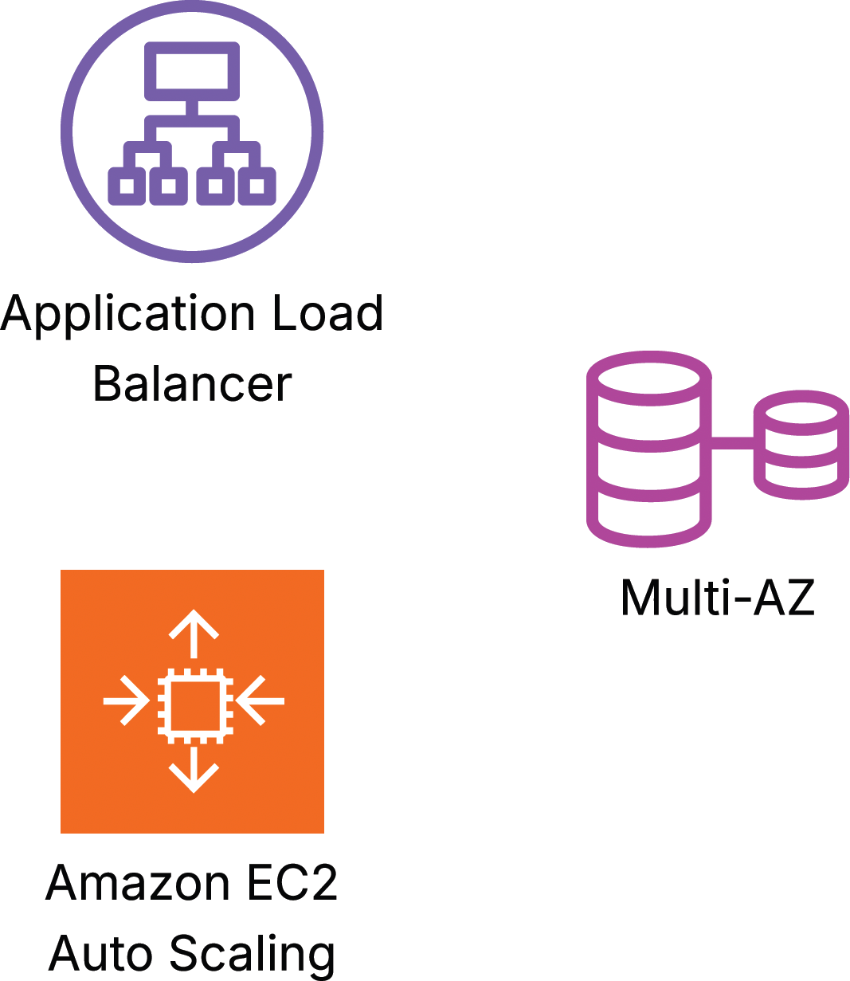
Making resources in the VPC scalable and higher in availability
The VPC could be improved by adding Application Load Balancing and EC2 Auto Scaling
The MySQL instance could be replicated across AZs by using Multi-AZ configuration

Slide 37
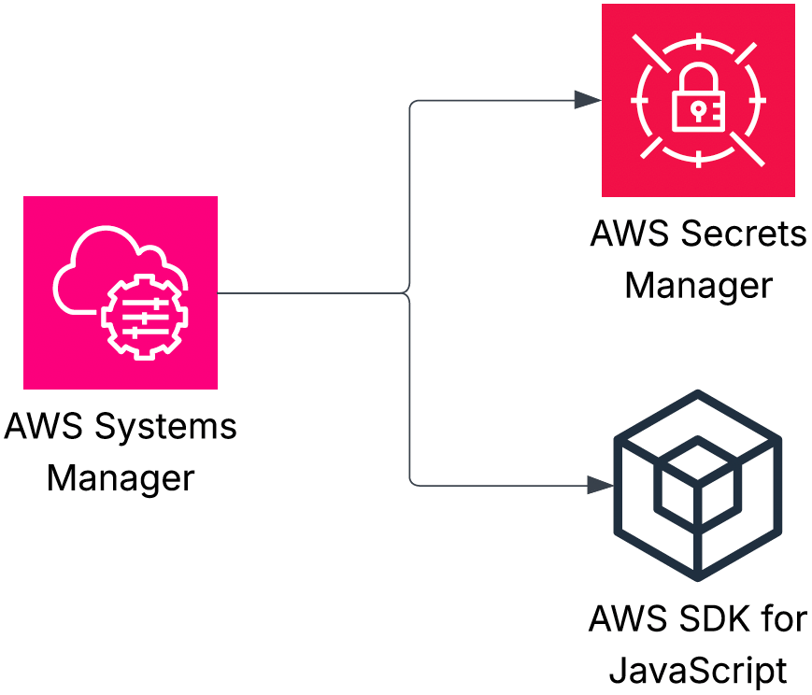
Implementing the database connection parameter storing & fetching in a different way
I could have implemented the storing and fetching of the parameters with AWS Secrets Manager instead of utilizing AWS Systems Manager Parameter Store
Also, using AWS SDK for JavaScript in Translation Game code to fetch the parameters was an option (I actually wrote the code halfway through until I decided to fetch them via my-web-server user data script)
    const AWS = require(“aws-sdk”)
    const parameterStore = new AWS.SSM()
    parameterStore.getParameters()
    …

Slide 38

Implementing a sign-in process for Curriculus
In its current state, Curriculus saves every users’ entries into the same DynamoDB table (my-records-tbl), without differentiating the entries by user in any way
  This, of course, isn’t the way we want a production-state application to function
A better implementation would be to continue saving the entries into the same table, but starting to differentiate them by user
  This could be done by using the partition and/or sort keys to store user differentiating information like usernames
In order to have the users have usernames in the first place, some kind of user registration and sign-in processes should be put into place
Also, a password storing solution is needed
  One way to implement all of them is with Amazon Cognito

Slide 39


Scoping roles and permitting least privilege more accurately
Naming some of the used resources accurately has been somewhat challenging
IAM role naming has been especially challenging because of a scoping dilemma
  Should I create a role just for this one specific use case? Or should I scope the role permissions so that the role can be used in two or even multiple use cases?
  A role’s scope affects its naming significantly
Some of the permissions I’ve assigned to, for example, to roles have more permissions than the resources need to perform the job they’re expected to
  When creating a process (e.g. integrating a Lambda function to an EventBridge schedule), it’s been so much easier to get it to work by assigning “extra permissions” than assigning only the exact needed permissions
  Some of the processes still have excess permissions that are waiting to be dealt with

Slide 40
An exhaustive list of concepts I’ve gotten practice at 1/3
Amazon VPC
  Attaching internet gateways
  Creating subnets and configuring their route tables
  Configuring network ACLs and security groups
  Configuring VPC peering connections between VPCs
    Configuring route tables and security groups to allow traffic flow
  Creating VPC Flow Logs and sending/publishing the data to S3 buckets
  (and CloudWatch Logs) to analyze traffic within a VPC
  Allocating Elastic IPs and associating them with EC2 instances
Amazon EC2
  Managing instance states, changing instance types, and viewing instance metadata
  Associating instances with security groups and IAM roles
  Launching instances with user data scripts
  Connecting to instances (with EC2 Instance Connect and Session Manager),
  then viewing instance logs
  Creating EC2 Auto Scaling groups
    Creating AMIs and launch templates
    Configuring scheduled scaling
    Attaching Application Load Balancers to ASGs
      Creating target groups
      Configuring target tracking policies
      Configuring ALBs to conduct health checks on instances
Amazon Elastic Block Store (EBS)
  Creating volumes and snapshots
  Attaching and detaching volumes to/from EC2 instances
Amazon Simple Storage Service (S3)
  Using general purpose buckets to host static websites and SPAs
  Configuring buckets with server access logging, versioning, event notifications, live replication, and lifecycle rules
  Editing bucket policies
Amazon Elastic File System (EFS)
  Creating file systems and mounting them to EC2 instances (i.e. creating mount targets on subnets)
  Connecting additional EC2 instances to existing file systems
  Sharing files between EC2 instances in a file system
Amazon Relational Database Service (RDS)
  Launching DB instances (Aurora, MySQL)
  Associating DB instances with security groups
  Configuring Multi-AZ deployments (standby replicas and read replicas)
  Configuring backups/creating snapshots
Amazon DynamoDB
  Creating tables
  Adding items to tables, then querying and scanning them (via AWS Management Console)
  Deploying DAX clusters

Slide 41
An exhaustive list of concepts I’ve gotten practice at 2/3
AWS Identity and Access Management (IAM)
  Creating users, user groups, permission policies, and roles
  Attaching permission policies to users, groups, and roles
  Attaching users to user groups and roles to resources
  Creating access keys and assigning them to users
  Configuring MFAs
AWS Lambda
  Creating, deploying, and testing functions
  Configuring functions with triggers and destinations
  Assigning execution roles to functions
  Using functions with external packages
Amazon CloudFront
  Deploying CDN download distributions
  Configuring EC2 instances and S3 hosted websites as distribution origins
  Invalidating cache items
Amazon Route 53
  Mapping IP addresses to domain names (i.e. creating hosted zones)
  Creating A, NS, SOA, and CNAME records
Amazon API Gateway
  Creating, staging, and deploying REST APIs
  Configuring REST APIs with resources and methods
  Enabling CORS
  Invoking Lambda functions by using API Gateway proxy integration
Amazon CloudWatch
  Inspecting log streams to troubleshoot deployments
  Creating alarms and actions
    Sending notifications to SNS topics
    Performing EC2 actions
  Creating dashboards
AWS CloudTrail
  Creating trails to log and monitor activity and data events in AWS resources and APIs
Amazon Data Firehose
  Creating streams to ingest data
AWS Glue
  Creating databases and crawlers to crawl data
Amazon Athena
  Creating databases and queries to analyze data
Amazon Simple Notification Service (SNS)
  Creating topics
  Subscribing (SQS queues, email addresses etc.) to topics
  Setting up DLQs
Amazon Simple Queue Service (SQS)
  Creating standard and FIFO queues

Slide 42
An exhaustive list of concepts I’ve gotten practice at 3/3
Amazon EventBridge
  Creating rules and schedules
    Configuring event patterns and targets
Amazon Elastic Container Registry (ECR)
  Creating repositories and Docker images
  Pushing Docker images into repositories
Amazon Elastic Container Service (ECS) & AWS Fargate
  Deploying applications by using images from Amazon ECR
    Creating task definitions
AWS CloudFormation
  Creating stacks/templates with AWS Infrastructure Composer
  Generating templates from existing resources with IaC generator
    Scanning account resources, then creating and importing templates to CloudFormation
AWS Backup
  Centralizing and automating data protection across AWS services
  Creating custom backup vaults
  Creating on-demand backups for EBS volumes
    Creating automated backup plans for EBS volumes using tags
AWS Config
  Creating managed rules for versioning, encryption, and resource tagging
AWS Systems Manager
  Using Parameter Store to store parameters
  Fetching parameters from the store
AWS Certificate Manager
  Requesting TLS certificates
AWS Cloud Development Kit (CDK)
  Using code constructs on IDEs (Amazon Sagemaker Studio) to create AWS resources
  Using Amazon Q Developer to suggest code
AWS Cost Explorer & AWS Cost and Usage Reports
  Analyzing costs and usage
AWS Budgets
  Creating budgets and budget alerts
AWS Pricing Calculator
  Making price estimates for use cases
AWS Resource Explorer
  Listing and examining resources
AWS SDKs
  for Python (Boto3)
  for JavaScript (v3)
Amazon Managed Service for Apache Flink
  Creating streaming applications

Slide 43
Thank you for your interest!
joni-makinen@live.fi
+358405882001
jonimakinen.com
linkedin.com/in/joni-daniel-makinen/
github.com/jonidaniel

